Slide 1


Predicting Car Insurance Claims
A data-driven modeling approach
DATA DYNAMOS

Slide 2

Overview
Introduction
Data Cleaning and Exploration Modeling and Evaluation Business Insights

Slide 3

Objective
To create predictive models that assess the probability of a policyholder submitting a car insurance claim in the next six months using existing features related to the policyholder and the vehicle.

Slide 4
Assumptions Made
The training dataset reflects the characteristics of future policyholders
Features that have undergone PCA transformation contain relevant predictive data.
There is a class imbalance that requires modifications, which have been managed using SMOTE.
We assumed that each row (policyholder data) is independent of others, meaning no repeated or time-series data is involved.

Slide 5
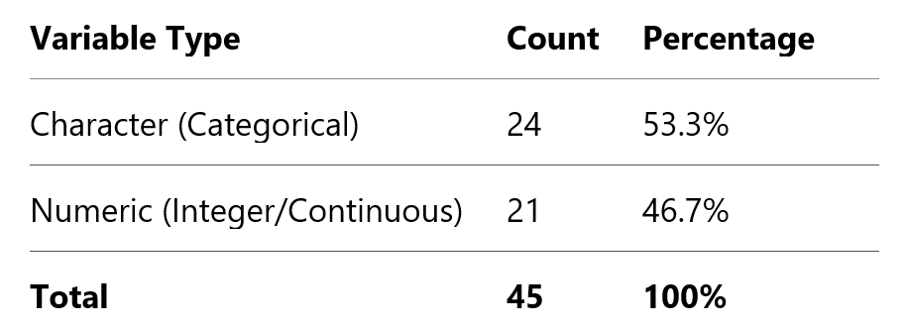
Data Cleaning
Reviewed the dataset structure, shape, and variable types.
Identified and reviewed categorical (character) columns for further processing.
No missing values were found — dataset was complete and required removal of rows/columns.

Slide 6
Exploratory Data Analysis

Slide 7
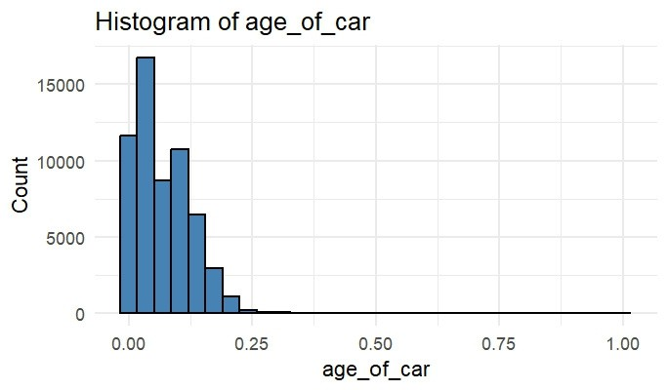
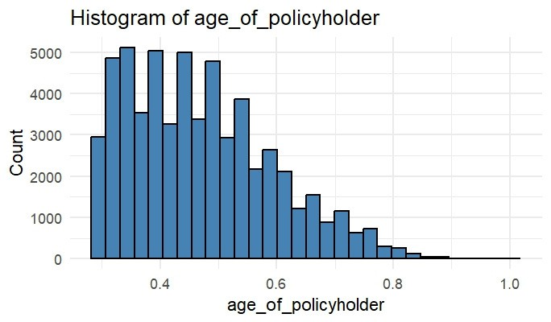
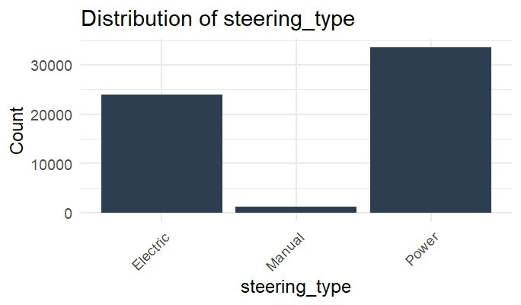
Univariate Analysis of Key Features

Slide 8
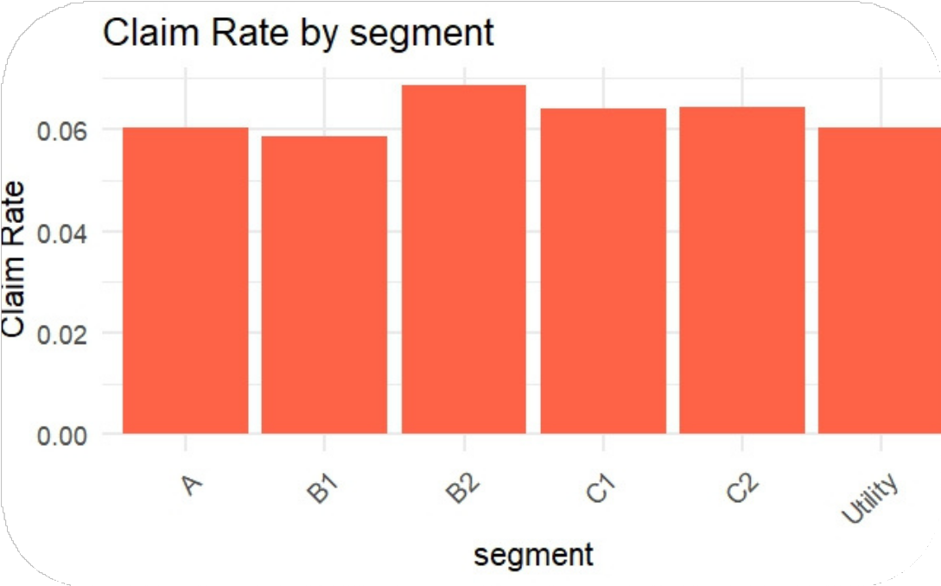
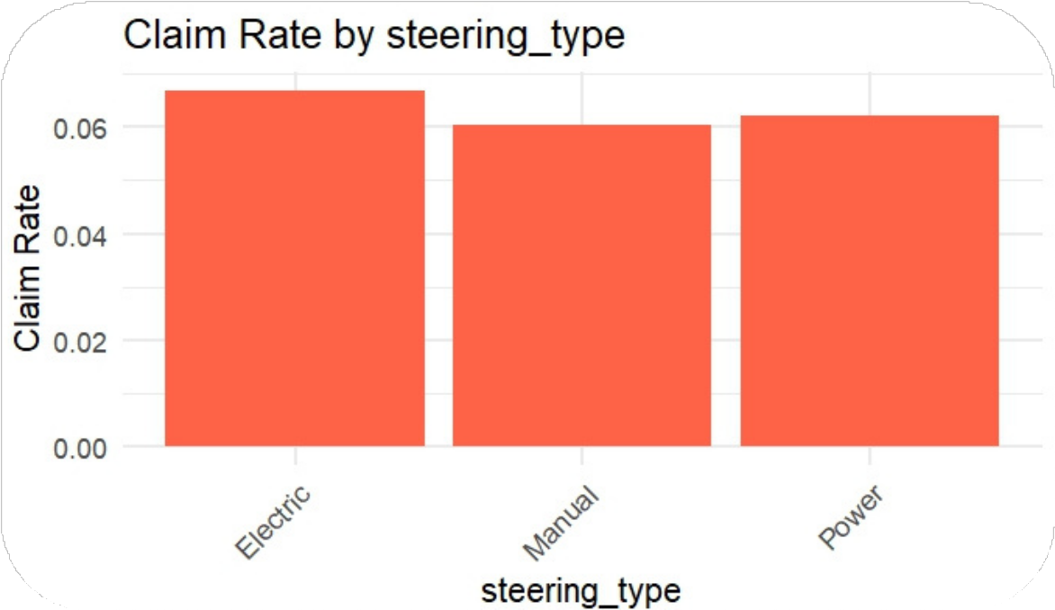
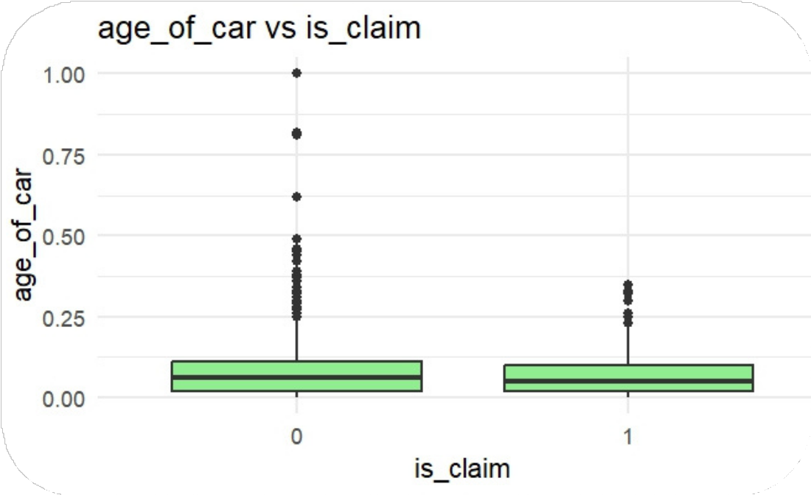
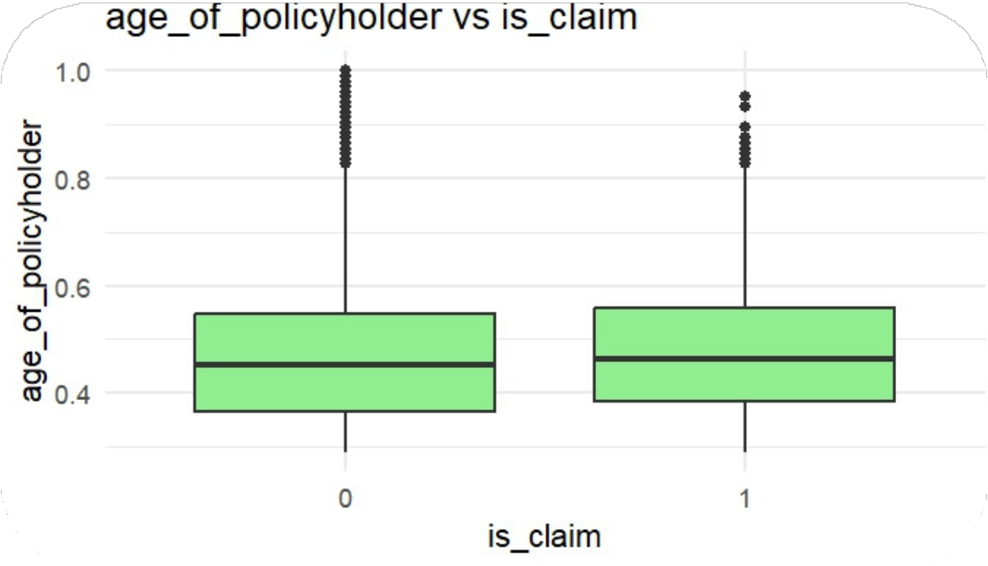
Bivariate Analysis with is_claim

Slide 9
Feature Engineering and Preprocessing
Converted binary columns (Yes/No) to numeric 1/0
The max_torque and max_power text columns were parsed to extract their numeric values
All numeric features were scaled using Min-Max normalization.
Created a new column volume as length × width × height to better capture the overall size of the vehicle in a single numeric variable.
Dropped policy_id, length, width and height.
One-hot encoded categorical variables.

Slide 10
Principal Componenet Analysis
To reduce dimensionality and minimize high correlations, we applied (PCA) using the correlation matrix.
The first 15 principal components were retained, capturing ~79.62% of the total variance.
This preserved the most important information while reducing noise and redundancy for modeling.

Slide 11
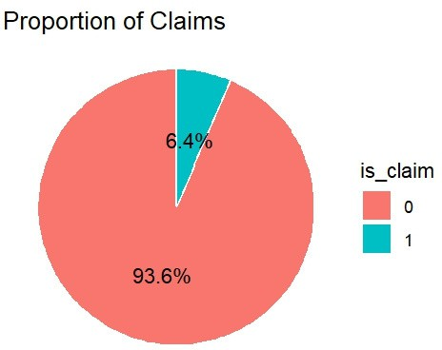
Handling Class Imbalance with SMOTE
The dataset was split into 70% training and 30% testing.
Due to the imbalance in claim vs. non-claim cases, we applied SMOTE (Synthetic Minority Over-sampling Technique).
SMOTE generated synthetic samples for the minority class, improving the model's ability to detect rare claim events.

Slide 12
Models
Logistic regression
Decision tree
Random forest

Slide 13
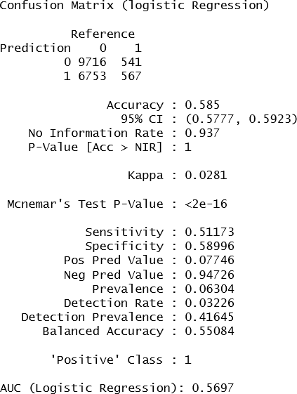
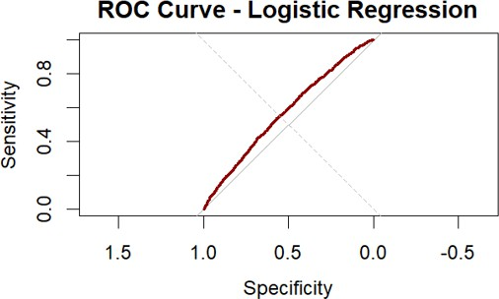
Logistic Regression

Slide 14
Logistic Regression Results (Interpretation of Coefficients)
Top Predictive Components:
PC12 → Strongest negative effect on claim probability (Estimate = –0.171, p < 0.001) PC13 → Strong positive effect (+0.127, p < 0.001)
PC11 & PC14 → Significant negative effects
PC3, PC5, PC15 → Not statistically significant (p > 0.05)

Slide 15
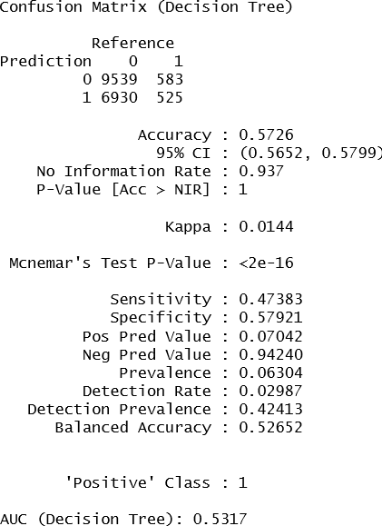
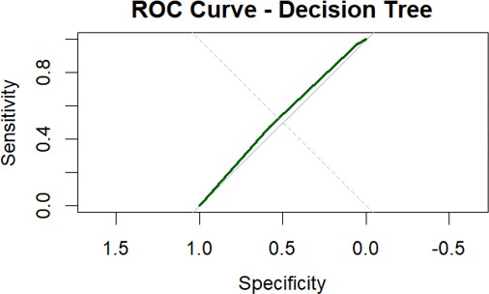
Decision Tree

Slide 16
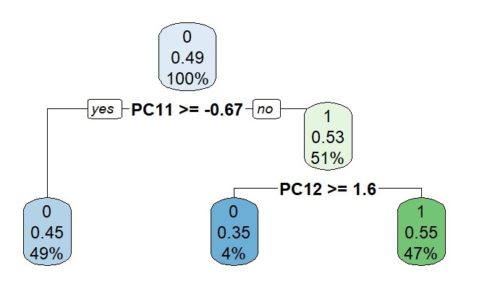
Decision Tree Interpretation
Class Imbalance Reflected
Most predictions are for class 0 (no claim).
Only a small portion of the data (47%) leads to predicting class 1.

Slide 17
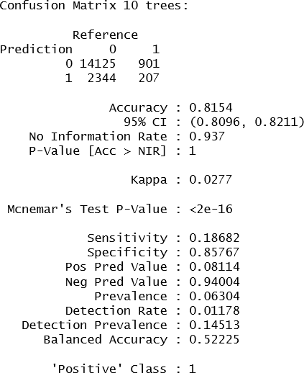
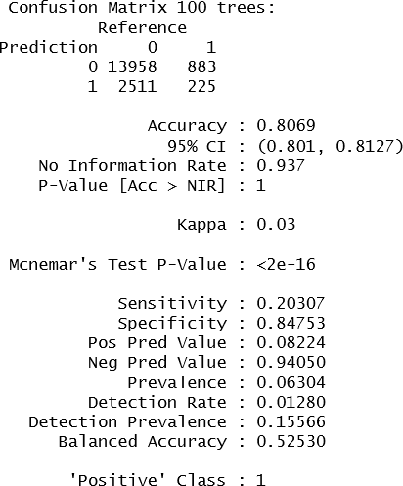
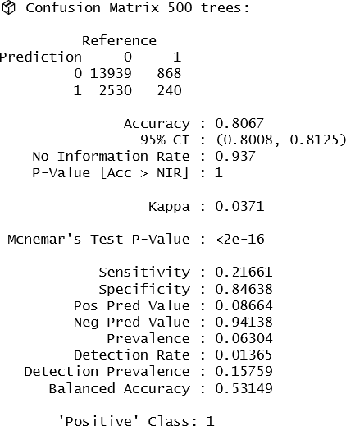
Random Forest

Slide 18
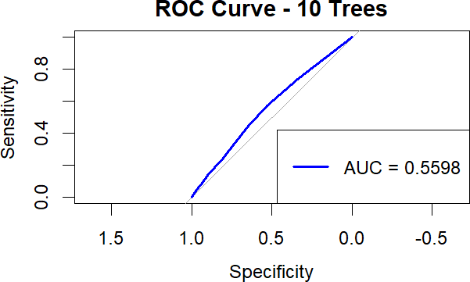
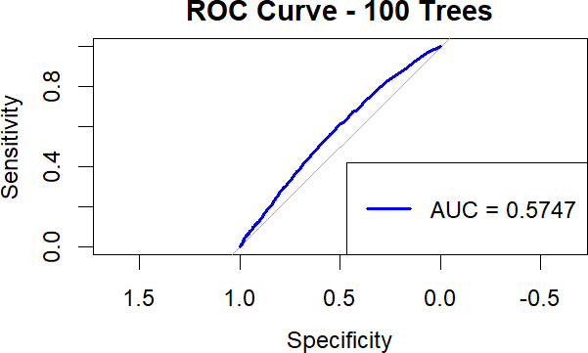


Slide 19
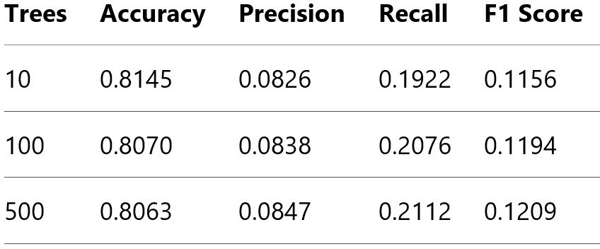
Comparison of Random Forest Trees

Slide 20
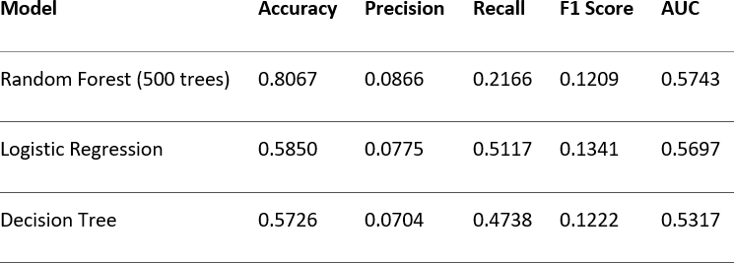
Model Performance Comparison

Slide 21
Recommendation & Limitation
We recommend Logistic Regression for its highest recall, critical for identifying likely claimants despite lower accuracy.
Its strong interpretability supports transparent, defensible underwriting decisions. This transparency is vital in regulated industries like insurance.
Despite its strengths, Logistic Regression may miss complex patterns that tree-based models can capture, potentially limiting predictive power. Future iterations could explore ensemble methods to improve performance while retaining interpretability.

Slide 22
Business Insights
Accurately predicting claimants helps insurers enhance pricing, underwriting, and resource allocation.
High-recall models like logistic regression flag more high-risk clients for review or premium adjustment, minimizing unexpected losses.
These insights also support targeted outreach, fraud detection, and customer segmentation.

Slide 23
THANK YOU

